Slide 1
AP Macroeconomics – Week 6

Slide 2
‘Chains of Events’
6.4: FP, MP and Exchange Rates
  Expansionary fiscal policy→↑Real Interest Rate (crowding out) →↑Capital Inflows→↑Exchange Rate
Expansionary MP →↑MS→↓Interest Rate→↓Capital Flows→↓Demand for the currency →↓Exchange Rate
6.5: ER and Net Exports
↑Exchange Rate will lead to a fall in Net exports (↑imports↓exports)
  This will lead to a fall in AD.
↓Exchange Rate will lead to a increase in net exports (↑exports↓imports).
  This will lead to an increase in AD.
6.6 Capital Inflows and Capital Formation
Capital Inflows→↑Demand for currency →↑Exchange Rate →↓Net Exports →↓AD
Capital inflows→↑Supply Loanable Funds →↑Private borrowing and investment →↑Capital Formation
Expansionary fiscal policy→↑Real Interest Rate (crowding out)
→↑Supply Loanable Funds →↑Private borrowing and investment →↑Capital Formation
→↑Capital Inflows→
↑Exchange Rate
→↑ AD
(↓Tax, ↑Gov exp.)
Contractionary Monetary Policy
→↓MS→↑Interest Rate (Money Mkt)
Note: For Contractionary Fiscal Policy and Expansionary MP, the same chain but opposite effects.
  →↓Net exports (↑imports↓exports)→↓AD
→↑ AD
(↓ C, I)

Slide 3
‘Chains of Events’
6.4: FP, MP and Exchange Rates
  Expansionary fiscal policy→↑Real Interest Rate (crowding out) →↑Capital Inflows→↑Exchange Rate
Expansionary MP →↑MS→↓Interest Rate→↓Capital Flows→↓Demand for the currency →↓Exchange Rate
6.5: ER and Net Exports
↑Exchange Rate will lead to a fall in Net exports (↑imports↓exports)
  This will lead to a fall in AD.
↓Exchange Rate will lead to a increase in net exports (↑exports↓imports).
  This will lead to an increase in AD.
6.6 Capital Inflows and Capital Formation
Capital Inflows→↑Demand for currency →↑Exchange Rate →↓Net Exports →↓AD
Capital inflows→↑Supply Loanable Funds →↑Private borrowing and investment →↑Capital Formation
Expansionary fiscal policy→↑Real Interest Rate (crowding out)
→↑Supply Loanable Funds →↑Private borrowing and investment →↑Capital Formation
→↑Capital Inflows→
↑Exchange Rate
→↑ AD
(↓Tax, ↑Gov exp.)
Contractionary Monetary Policy
→↓MS→↑Interest Rate (Money Mkt)
Note: For Contractionary Fiscal Policy and Expansionary MP, the same chain but opposite effects.
  →↓Net exports (↑imports↓exports)→↓AD
→↑ AD
(↓ C, I)

Slide 4
Prior Knowledge
We know:
  Exchange rates can affect exports and imports
    ↑ER→ ↓Net Exports
    ↓ER → ↑Net Exports

Slide 5




Appreciation and Depreciation Consequences Summarized
Summary
Appreciation →↓(X-M)
Depreciation→ ↑(X-M)
Appreciation
= ↑Purchasing Power →↑Imports (because imports are now cheaper) and ↓Exports (because for foreigners our products are more expensive)
→ ↓AD
Depreciation
= ↓Purchasing Power → ↓Imports (because imports are now more expensive to buy with our currency) and ↑Exports (because for foreigners our products are cheaper)
→ ↑AD
Crash Course
https://youtu.be/geoe-6NBy10?t=326

Slide 6
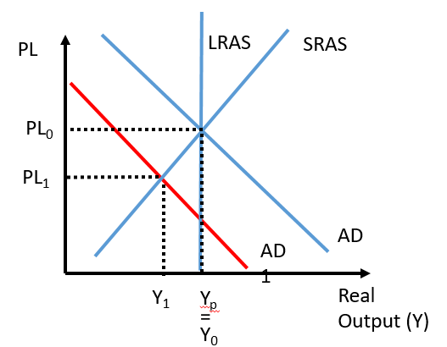
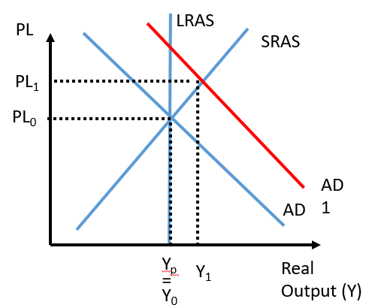
Exchange Rate affects Net Exports, affects AD
Summary
↓Exchange Rate →↑(X-M) →↑AD
↑Exchange Rate → ↓(X-M) → ↓ AD
↑Exchange Rate will lead to a fall in Net exports (↑imports↓exports)
  This will lead to a fall in AD.
↓Exchange Rate will lead to a increase in net exports (↑exports↓imports).
  This will lead to an increase in AD.
This effect on AD will then have an effect on Output (Y) and Unemployment.
↑Output
↓Unemployment
↓Output
↑Unemployment

Slide 7
The Chinese Yuan appreciates in value. What would be the effect on net exports for China? How would this affect output?
Net exports would decrease.
  Exports are more expensive for foreigners and so they buy less.
  Imports are cheaper for Chinese people and so they buy more.
Output would decrease because ↓(X-M)↓AD →↓Output
The New Zealand dollar depreciates in value. What would be the effect on net exports for New Zealand? How would this affect unemployment?
Net exports would increase.
  Exports are cheaper for foreigners and so they buy more.
  Imports are more expensive for New Zealand people and so they buy less.
Unemployment would decrease because ↑(X-M)→↑AD→ ↑Output →↓Unemployment

Slide 8
What will be the effect of an increase on the exchange rate on AD? What will happen to unemployment?
An increase in the exchange rate will:
  Net exports will decrease
    Make imports more affordable for locals so they will buy more
    Make exports more expensive for foreigners so they will buy less
  AD will decrease
  Unemployment will increase.

Slide 9
‘Chains of Events’
6.4: FP, MP and Exchange Rates
  Expansionary fiscal policy→↑Real Interest Rate (crowding out) →↑Capital Inflows→↑Exchange Rate
Expansionary MP →↑MS→↓Interest Rate→↓Capital Flows→↓Demand for the currency →↓Exchange Rate
6.5: ER and Net Exports
↑Exchange Rate will lead to a fall in Net exports (↑imports↓exports)
  This will lead to a fall in AD.
↓Exchange Rate will lead to a increase in net exports (↑exports↓imports).
  This will lead to an increase in AD.
6.6 Capital Inflows and Capital Formation
Capital Inflows→↑Demand for currency →↑Exchange Rate →↓Net Exports →↓AD
Capital inflows→↑Supply Loanable Funds →↑Private borrowing and investment →↑Capital Formation
Expansionary fiscal policy→↑Real Interest Rate (crowding out)
→↑Supply Loanable Funds →↑Private borrowing and investment →↑Capital Formation
→↑Capital Inflows→
↑Exchange Rate
→↑ AD
(↓Tax, ↑Gov exp.)
Contractionary Monetary Policy
→↓MS→↑Interest Rate (Money Mkt)
Note: For Contractionary Fiscal Policy and Expansionary MP, the same chain but opposite effects.
  →↓Net exports (↑imports↓exports)→↓AD
→↑ AD
(↓ C, I)

Slide 10
Prior Knowledge
We know:
  FP Affects Interest Rates
    Expansionary FP→ ↑Budget Deficit →↑Government Borrowing →↑D_{LF} (or ↓S_{LF})→↑IR
    Contractionary FP→ ↓ Budget Deficit → ↓ Government Borrowing → ↓ D_{LF} (or ↑S_{LF})→ ↓ IR

Slide 11
What effect does a Budget Deficit have on the interest rate?
Budget deficits lead to government borrowing and a higher interest rate.

Slide 12


Two Meanings of Capital
Summary
Capital = equipment and machines
Capital = money
Somewhat confusingly, capital can take on slightly different meanings depending on the context, similar to many words in English (eg. Lunch break vs break computer, Wrist watch vs watch TV etc.)
Capital = Equipment and Machines
If you see the terms:
  Capital stock
  Capital formation
  Capital goods
  Investment in capital
This refers to equipment and machines which firms use to help produce goods.
Capital = money
If you see the terms:
  Capital inflows/outflows
  Foreign capital
This refers to money which is lent to businesses and used by businesses.

Slide 13
If a question asks about ‘capital inflows’ does this refer to money or machines and equipment?
Money
In this case it is money that people are putting into the financial system often in the form of savings in the banks

Slide 14
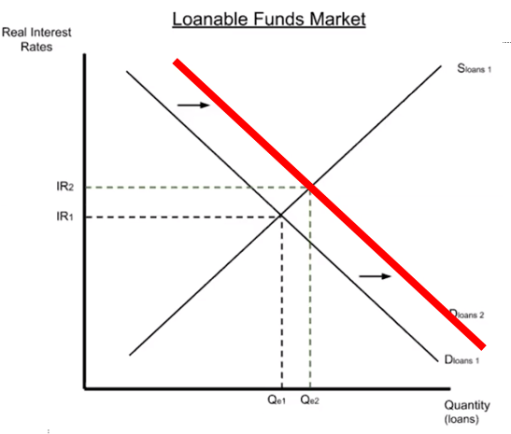
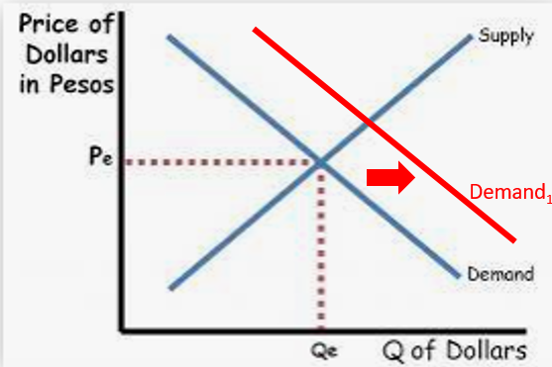
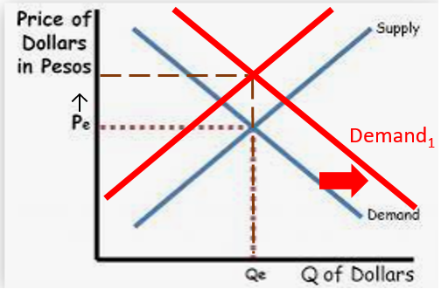
Expansionary Fiscal Policy, Interest Rates and Exchange Rates
Summary
Expansionary FP and Exchange Rate are connected.
  Expansionary fiscal policy→↑Real Interest Rate →↑Capital Inflows→↑ Demand for currency→↑ Exchange Rate
Expansionary fiscal policy→↑G↓T→↑Budget Deficit→↑Government borrowing →↑D_{LF}→↑Real Interest Rate
And:
↑Interest rates→↑net capital inflows (means investors wish to put their money into a country) where it will earn the highest returns.
  →↑Demand for that country’s currency→↑Exchange Rate
Therefore, Expansionary fiscal policy leads to an appreciation of the exchange rate.
  Expansionary fiscal policy→↑Real Interest Rate (crowding out) →↑Capital Inflows→↑Exchange Rate
Increased government borrowing increases the IR.
The increased IR attracts capital inflows a ↑Demand of that currency
and
Note: We could also draw a decrease of supply of currency.

Slide 15
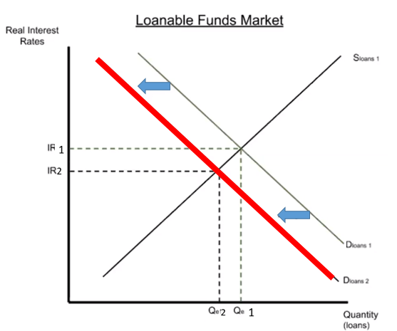
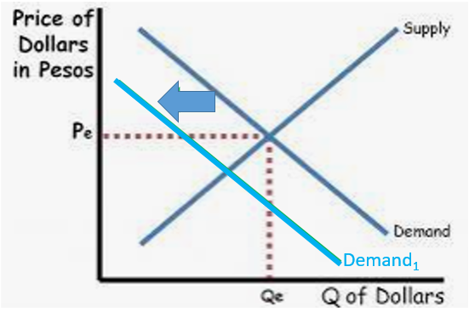
Contractionary Fiscal Policy, Interest Rates and Exchange Rates
Summary
  Contractionary fiscal policy→ ↓ Real Interest Rate → ↓ Capital Inflows→ ↓ Exchange Rate
Less government borrowing actually means →↓ D_{LF} ↓ IR
Contractionary fiscal policy→ ↓G↑T→ ↓ Budget Deficit→ ↓ Government borrowing → ↓ D_{LF}→ ↓ Real Interest Rate
And :
  ↓ interest rates→ ↓ net capital outflows (means investors wish to move their money out to a different country) where it will earn the highest returns.
  → ↓ Demand for that country’s currency→ ↓ Exchange Rate
Therefore, Contractionary fiscal policy leads to an depreciation of the exchange rate.
  Contractionary fiscal policy→ ↓ Real Interest Rate → ↓ Capital Inflows→ ↓ Exchange Rate
Supply₁
Lower interest rate leads to ↓net capital inflows →↓D_{dollars}↑S_{dollars}
Note: We could also draw an increase of supply of currency.

Slide 16
What is the effect of expansionary FP on the exchange rate? Give a description of how this occurs.
  Expansionary fiscal policy→↑Real Interest Rate →↑Capital Inflows→↑ Demand for currency→↑ Exchange Rate

Slide 17
‘Chains of Events’
6.4: FP, MP and Exchange Rates
  Expansionary fiscal policy→↑Real Interest Rate (crowding out) →↑Capital Inflows→↑Exchange Rate
Expansionary MP →↑MS→↓Interest Rate→↓Capital Flows→↓Demand for the currency →↓Exchange Rate
6.5: ER and Net Exports
↑Exchange Rate will lead to a fall in Net exports (↑imports↓exports)
  This will lead to a fall in AD.
↓Exchange Rate will lead to a increase in net exports (↑exports↓imports).
  This will lead to an increase in AD.
6.6 Capital Inflows and Capital Formation
Capital Inflows→↑Demand for currency →↑Exchange Rate →↓Net Exports →↓AD
Capital inflows→↑Supply Loanable Funds →↑Private borrowing and investment →↑Capital Formation
Expansionary fiscal policy→↑Real Interest Rate (crowding out)
→↑Supply Loanable Funds →↑Private borrowing and investment →↑Capital Formation
→↑Capital Inflows→
↑Exchange Rate
→↑ AD
(↓Tax, ↑Gov exp.)
Contractionary Monetary Policy
→↓MS→↑Interest Rate (Money Mkt)
Note: For Contractionary Fiscal Policy and Expansionary MP, the same chain but opposite effects.
  →↓Net exports (↑imports↓exports)→↓AD
→↑ AD
(↓ C, I)

Slide 18
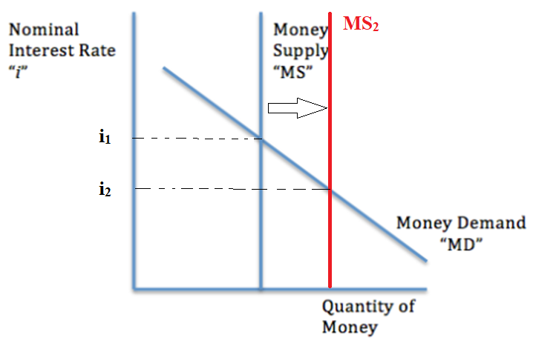
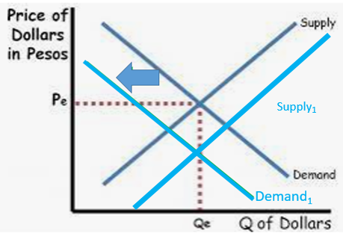
Expansionary MP and Exchange Rate
Summary
  Expansionary MP→↓IR→↓Net Capital Inflows→↓Exchange Rate
Expansionary Monetary Policy →↑MS→↓Interest Rate
As we have covered previously, ↓Interest Rate→↓Net Capital inflows→↓Demand for the currency →↓Exchange Rate
Therefore, we can observe a relationship between Monetary Policy and exchange rate.
Note: We could also draw an increase of supply of currency.
Summary
There is a relationship between Monetary Policy and Exchange Rate.
Expansionary MP →↑MS→↓Interest Rate→↓net Capital inFlows→↓Demand for the currency →↓Exchange Rate

Slide 19
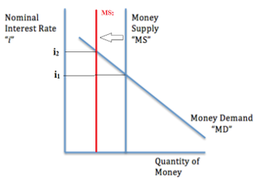
Contractionary Monetary Policy and Exchange Rate
Summary
  Contractionary MP→↑IR→↑Net Capital Inflows→↑Exchange Rate
Contractionary MP will have the opposite effect of that shown on the previous slide.
Contractionary Monetary Policy →↓MS→↑Interest Rate
As we have covered previously, ↑Interest Rate→↑Capital Flows→↑Demand for the currency →↑Exchange Rate
Note: We could also draw a decrease of supply of currency.

Slide 20
Expansionary MP →↑MS→↓Interest Rate→↓Capital Flows→↓Demand for the currency →↓Exchange Rate
Contractionary MP →↓MS→↑Interest Rate→↑Capital Flows→↑Demand for the currency →↑Exchange Rate

Slide 21
What is the effect of expansionary MP on the exchange rate? Give a description of how this occurs.
Expansionary MP →↑MS→↓Interest Rate→↓Net Capital Flows→↓Demand for the currency →↓Exchange Rate
What is the effect of contractionary MP on the exchange rate? Give a description of how this occurs.
Contractionary MP →↓MS→↑Interest Rate→↑Net Capital Flows→↑Demand for the currency →↑Exchange Rate

Slide 22
Summary: FP, MP and Exchange Rates
Summary
  Expansionary FP→↑Net Capital Inflows→↑ Exchange Rate
  Expansionary MP→↓Net Capital Inflows →↓ Exchange Rate
  Expansionary fiscal policy→↑Real Interest Rate →↑Net Capital Inflows→↑Exchange Rate
Expansionary MP →↑MS→↓Interest Rate→↓Net Capital Inflows→↓Demand for the currency →↓Exchange Rate

Slide 23
FP and MP, Interest Rates, Exchange Rates
FP and MP
Interest Rate
Net Capital inflows
Exchange Rate
Interest Rate is linked to Exchange rate due to capital flows.
FP and MP is connected to the Interest Rate.
Therefore, FP and MP is connected to the Exchange Rate.

Slide 24
Determinants of Demand/Supply of Currency
Determinants of Currency Demand
Tastes and Preferences
Income Level
Interest Rates
  Monetary Policy (Expansionary MP→↓Interest Rate)
  Fiscal Policy (Expansionary FP→↑Interest Rate)
Price Level (Inflation)
Trade Policies (eg. Taxes on imports)
Expectations of Future Exchange Rate

Slide 25
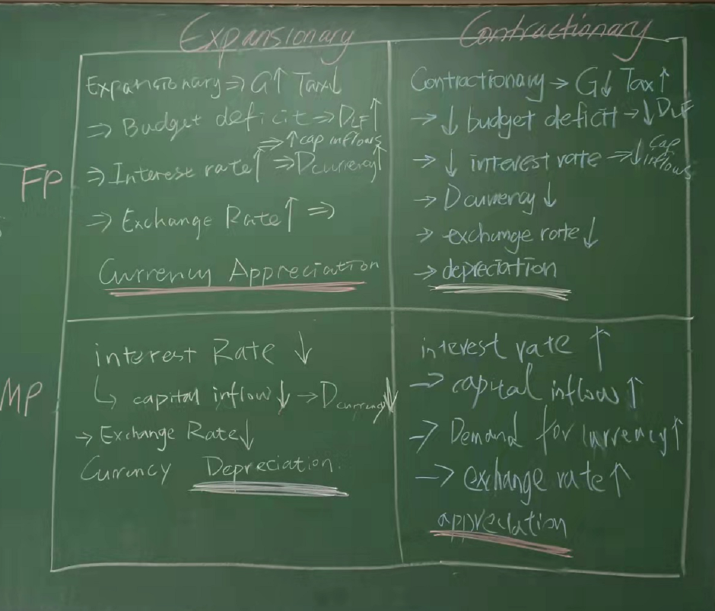

Slide 26
Combining 6.4 and 6.5
6.4: FP, MP and Exchange Rates
  Expansionary fiscal policy→↑Real Interest Rate (crowding out) →↑Capital Inflows→↑Exchange Rate
Expansionary MP →↑MS→↓Interest Rate→↓Capital Flows→↓Demand for the currency →↓Exchange Rate
6.5: ER and Net Exports
↑Exchange Rate will lead to a fall in Net exports (↑imports↓exports)
  This will lead to a fall in AD.
↓Exchange Rate will lead to a increase in net exports (↑exports↓imports).
  This will lead to an increase in AD.
6.6 Capital Inflows and Capital Formation
Capital Inflows→↑Demand for currency →↑Exchange Rate →↓Net Exports →↓AD
Capital inflows→↑Supply Loanable Funds →↑Private borrowing and investment →↑Capital Formation
Expansionary fiscal policy→↑Real Interest Rate (crowding out)
→↑Supply Loanable Funds →↑Private borrowing and investment →↑Capital Formation
→↑Capital Inflows→
↑Exchange Rate
→↑ AD
(↓Tax, ↑Gov exp.)
Contractionary Monetary Policy
→↓MS→↑Interest Rate (Money Mkt)
Note: For Contractionary Fiscal Policy and Expansionary MP, the same chain but opposite effects.
  →↓Net exports (↑imports↓exports)→↓AD
→↑ AD
(↓ C, I)

Slide 27
Combining Unit 6.4 and 6.5
Expansionary FP/Contractionary MP→↑Interest Rate→↑Capital Inflows →↑D_{currency} →↑Exchange Rate →↓Exports, ↑Imports →↓Net Exports →↓AD→↓RGDP/Y/Income → ↑Unemployment
Contractionary FP/Expansionary MP→↓Interest Rate→↓Capital Inflows →↓D_{currency} →↓Exchange Rate →↑Exports, ↓Imports →↑Net Exports →↑AD →↑RGDP/Y/Income → ↓Unemployment
Expansionary FP and Contractionary MP
↑Interest Rate
FP and MP
↓ Interest Rate
↑ Capital Inflows
↓ Capital Inflows
↑ Exchange Rate
↓ Exchange Rate
↓Net Exports
↑ Net Exports
↑ Aggregate Demand
↓ Aggregate Demand

Slide 28
→↑blah
→↓blah
↓
Explain the effect of Expansionary FP on the unemployment rate.
Expansionary FP →↑AD→↓Unemployment
But also:
Expansionary FP →↑Budget Deficit→↑D_{LF}→↑IR→↑capital inflows→↑ER→↓Net Exports →↓AD→↑Unemployment

Slide 29
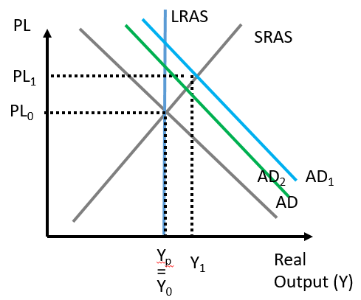
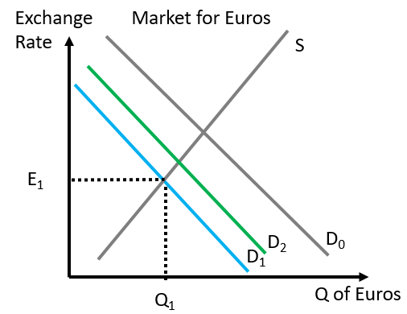
1st, 2nd, 3rd effects etc.
In some of the questions you will see that some relationship seem to have no end or will cancel each other out. While sometimes this is true, mostly we can think of earlier effects being stronger than later effects.
The first increase in AD will outweigh the reduction in AD.
Example 1:
Increase of X-M→↑AD→↑Incomes →↑Imports(wealthier people buy more imports) →↓X-M →↓AD
  Does this mean that AD is unchanged?
  No, AD will increase overall, because the 1st effect will be stronger than the 2nd effect.
Summary
The 1st effect of a movement > the 2nd effect, → a net movement the same as the 1st movement.
The first change in D will outweigh the second change in D.
Example 2
↓Exchange Rate→↑X-M (imports more expensive for locals, exports cheaper for foreigners) →↑D_{currency} → ↑Exchange Rate
  Will the exchange rate be unchanged?
  Again, the 1st effect of the Exchange Rate Effect will be larger than the 2nd effect

Slide 30
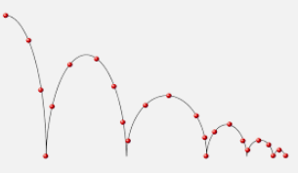

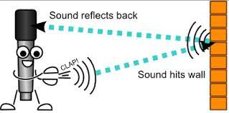
1st, 2nd, 3rd etc. effect - Analogies
Summary
Just like with a ball bouncing, we can assume that ‘1st effects’ will be stronger than ‘2nd effects, 3rd effects etc.’
A ball’s bounce will eventually find its resting point as the bounces become smaller, similar to movements in the economy.
The ripple will be strongest in the middle and weaker on the outside.
The echo that comes back will be weaker than the initial sound.

Slide 31
Why do macroeconomic events usually not ‘cancel each other out’?
The 1st effect is usually the strongest, so following events will not cancel out the 1st effect.

Slide 32
What is the first effect of expansionary FP on AD?
Increases AD through more gov spending and gov transfers and less tax.
What is the ‘second effect’ of expansionary FP on AD?
-> Budget Deficit -> Gov borrowing -> D_{LF} -> RIR -> capital inflows -> D_{curr} -> ER -> exports -> AD
What is the overall effect on AD?
An increase in AD because we can almost always assume the ‘1st effect’ is stronger than the ‘2nd effect’.

Slide 33
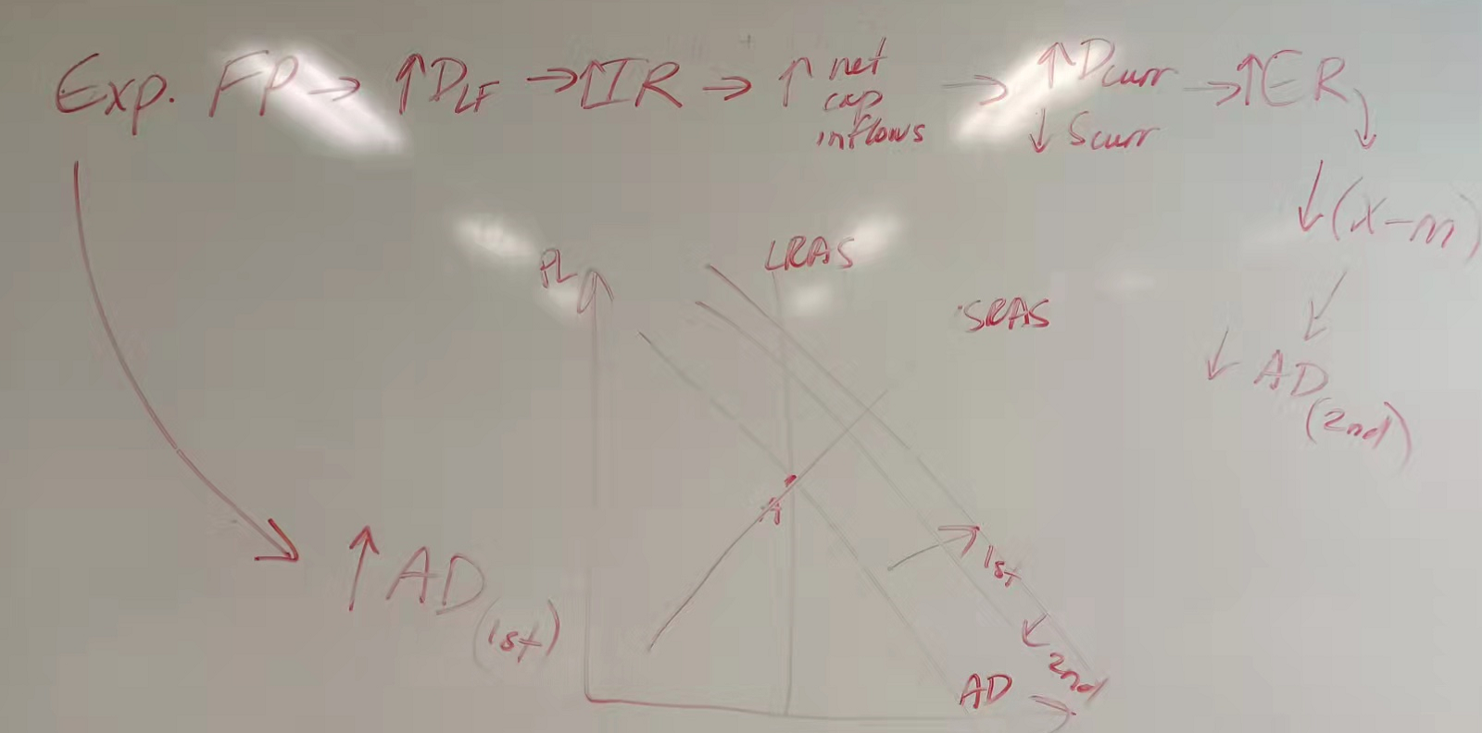

Slide 34
Investment: Private Domestic Investment vs Net Capital Inflows
Summary
Net capital inflows and private domestic investment are different.
↑IR→ ↑Net Capital Inflows
↑IR →↓Private Domestic Invesment
It is possible to confuse the two because they can both be described as investment.
Eg.
Putting money in a bank in that country
Buying Bonds
Net Capital Inflows
(Foreigners lend money and earn higher interest compared to putting money in other countries)
Interest Rate
Private Domestic Investment
(Local firms borrow money to expand production of their businesses.)
Eg.
Human Capital
Capital formation (machines and equipment)
Technology

Slide 35
When interest rates decrease in a country, what happens to net capital inflows into a country?
Decrease, because foreign investors can’t earn as much interest.
What happens to private domestic investment as a result of the interest rate decrease?
Increase, because cost of borrowing is lower and domestic firms can afford to borrow more and use this money to invest more in capital, human capital and technology.

Slide 36
Container Ship Loading and Unloading – YouTube
  To watch while students are doing questions
  Has some relevance to trade but otherwise no purpose for the course

Slide 37
6.6 The Exchange Rate, Government Policy and Capital Flows
6.4 focused on the different determinants of demand for currency and how the forex market interacts with other parts of the economy.
6.5 looked at the relationship between exchange rates and net exports and AD.
6.6 will connect 6.4 and 6.5 together and also connect with economic growth from Unit 5.

Slide 38
‘Chains of Events’
6.4: FP, MP and Exchange Rates
  Expansionary fiscal policy→↑Real Interest Rate (crowding out) →↑Capital Inflows→↑Exchange Rate
Expansionary MP →↑MS→↓Interest Rate→↓Capital Flows→↓Demand for the currency →↓Exchange Rate
6.5: ER and Net Exports
↑Exchange Rate will lead to a fall in Net exports (↑imports↓exports)
  This will lead to a fall in AD.
↓Exchange Rate will lead to a increase in net exports (↑exports↓imports).
  This will lead to an increase in AD.
6.6 Capital Inflows and Capital Formation
Capital Inflows→↑Demand for currency →↑Exchange Rate →↓Net Exports →↓AD
Capital inflows→↑Supply Loanable Funds →↑Private borrowing and investment →↑Capital Formation
Expansionary fiscal policy→↑Real Interest Rate (crowding out)
→↑Supply Loanable Funds →↑Private borrowing and investment →↑Capital Formation
→↑Capital Inflows→
↑Exchange Rate
→↑ AD
(↓Tax, ↑Gov exp.)
Contractionary Monetary Policy
→↓MS→↑Interest Rate (Money Mkt)
Note: For Contractionary Fiscal Policy and Expansionary MP, the same chain but opposite effects.
  →↓Net exports (↑imports↓exports)→↓AD
→↑ AD
(↓ C, I)

Slide 39
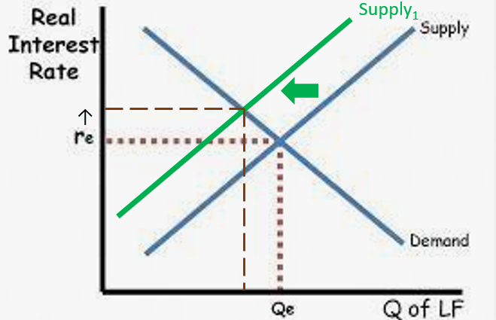
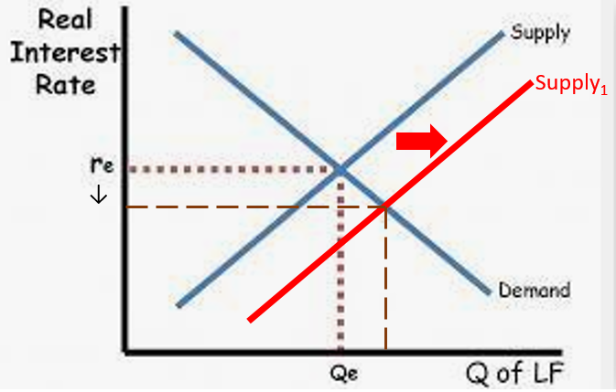
Interest Rates and Capital Inflows
Summary
The interest rate affects capital inflows which affects the supply of loanable funds
↑IR→ ↑capital inflows → ↑ Supply_{loanable} _{funds}
↓ IR→ ↓capital inflows → ↓ Supply_{loanable} _{funds}
Higher interest rates lead to capital inflows.
  Investors move their money to where it will earn higher interest
Higher interest can be caused by multiple factors but also includes FP and MP.
Lower interest rates lead to capital outflows.
  Investors move their money to where it will earn higher interest
Lower interest can be caused by multiple factors but also includes FP and MP:
Capital outflows mean less supply in the loanable funds market.
Capital inflows mean more supply in the loanable funds market.
Note: Interest Rates in an economy largely move together. So RIR and NIR can both be treated as IR.

Slide 40
Supply of Loanable Funds Affects Capital Formation
More Capital Formation
↑Capital inflows→↑Supply Loanable Funds →↑Private borrowing and investment →↑Capital Formation
Less Capital Formation
↓Capital inflows→↓Supply Loanable Funds →↓Private borrowing and investment →↓Capital Formation
Summary
↑IR→ ↑capital inflows → ↑ Supply_{loanable} _{funds} → ↑investment → ↑capital formation
↑IR→ ↓capital inflows → ↓ Supply_{loanable} _{funds} → ↓ investment → ↓ capital formation

Slide 41
As a result of a higher interest rate, what will happen to the capital inflows?
  Capital inflows will increase because foreign investors will move their money to your country in the form of bonds and depositing in banks.
As a result of more capital inflows, what would be the effect on total borrowing in the economy? Therefore what would happen to investment?
  The supply of loanable funds increase would lead to a larger equilibrium quantity of borrowed funds.
  We assume this will increase the amount of investment.

Slide 42
Combining 6.4 and 6.6
6.4: FP, MP and Exchange Rates
  Expansionary fiscal policy→↑Real Interest Rate (crowding out) →↑Capital Inflows→↑Exchange Rate
Expansionary MP →↑MS→↓Interest Rate→↓Capital Flows→↓Demand for the currency →↓Exchange Rate
6.5: ER and Net Exports
↑Exchange Rate will lead to a fall in Net exports (↑imports↓exports)
  This will lead to a fall in AD.
↓Exchange Rate will lead to a increase in net exports (↑exports↓imports).
  This will lead to an increase in AD.
6.6 Capital Inflows and Capital Formation
Capital Inflows→↑Demand for currency →↑Exchange Rate →↓Net Exports →↓AD
Capital inflows→↑Supply Loanable Funds →↑Private borrowing and investment →↑Capital Formation
Expansionary fiscal policy→↑Real Interest Rate
→↑Supply Loanable Funds →↑Private borrowing and investment →↑Capital Formation
→↑Capital Inflows→
↑Exchange Rate
→↑ AD
(↓Tax, ↑Gov exp.)
Contractionary Monetary Policy
→↓MS→↑Interest Rate (Money Mkt)
Note: For Contractionary Fiscal Policy and Expansionary MP, the same chain but opposite effects.
  →↓Net exports (↑imports↓exports)→↓AD
→↑ AD
(↓ C, I)

Slide 43
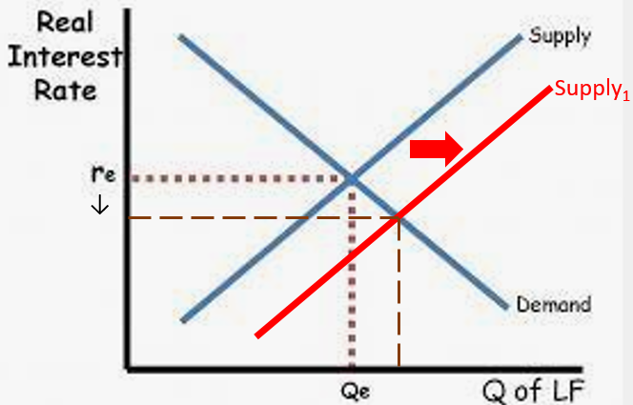
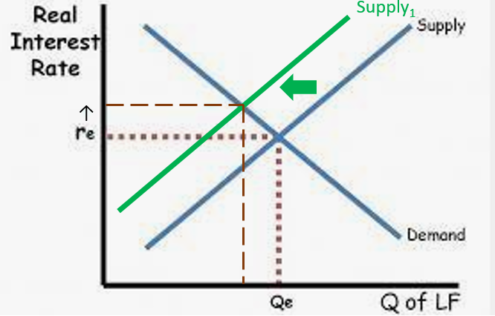
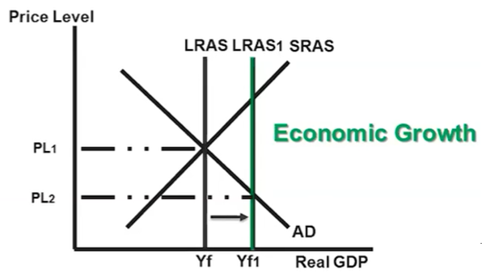
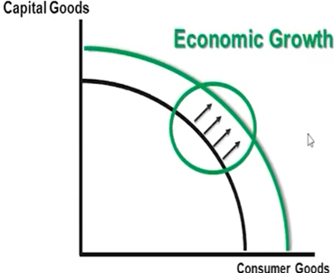
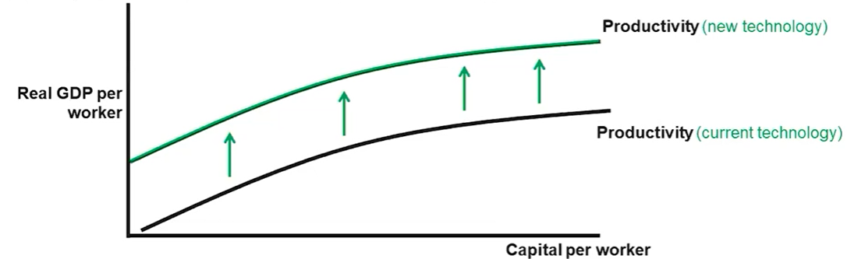
Summary:
FP and MP and effect on Capital Formation
Expansionary Fiscal Policy
  ↑G↓T→↑Government Borrowing→↑D_{LF} →↑Interest Rate (Loanable Funds Mkt)
Contractionary Monetary Policy
  ↓MS→↑Interest Rate (Money Mkt)
Contractionary Fiscal Policy
  ↓G↑T→ ↓Government Borrowing→ ↓DLF → ↓Interest Rate (Loanable Funds Mkt)
Expansionary Monetary Policy
  ↑MS→ ↓ Interest Rate (Money Mkt)
↑Capital Inflows
Capital Outflows
Capital Formation
Capital Formation
→ ↑Investment→ ↑ Capital Formation
→↓Investment→↓Capital Formation
↑S_{LF}→ ↑Private Borrowing
↓S_{LF}→↓Private Borrowing
LESS Economic Growth
More Economic Growth
Note: The growth rate will be slower but not necessarily negative.
Note: The growth rate will be slower but not necessarily negative.

Slide 44
Explain the effect that contractionary MP has on the interest rate.
Contractionary MP→↑Interest Rate
Using symbols, explain the effect that contractionary MP would have on capital formation as a result of changes to capital inflows?
  Contractionary MP→↑Interest Rate→↑Capital inflows→↑S_{LF}→↑Private Borrowing→↑Investment→↑Capital Formation

Slide 45
‘Unit 6: Chains of Events’
6.4: FP, MP and Exchange Rates
  Expansionary fiscal policy→↑Real Interest Rate (crowding out) →↑Capital Inflows→↑Exchange Rate
Expansionary MP →↑MS→↓Interest Rate→↓Capital Flows→↓Demand for the currency →↓Exchange Rate
6.5: ER and Net Exports
↑Exchange Rate will lead to a fall in Net exports (↑imports↓exports)
  This will lead to a fall in AD.
↓Exchange Rate will lead to a increase in net exports (↑exports↓imports).
  This will lead to an increase in AD.
6.6 Capital Inflows and Capital Formation
Capital Inflows→↑Demand for currency →↑Exchange Rate →↓Net Exports →↓AD
Capital inflows→↑Supply Loanable Funds →↑Private borrowing and investment →↑Capital Formation
Expansionary fiscal policy→↑Real Interest Rate
→↑Supply Loanable Funds →↑Private borrowing and investment →↑Capital Formation
→↑Capital Inflows→
↑Exchange Rate
→↑ AD
(↓Tax, ↑Gov exp.)
Contractionary Monetary Policy
→↓MS→↑Interest Rate (Money Mkt)
Note: For Contractionary Fiscal Policy and Expansionary MP, the same chain but opposite effects.
  →↓Net exports (↑imports↓exports)→↓AD
→↑ AD
(↓ C, I)

Slide 46
Unit 6 Summary
6.1 | Balance of Payments
6.2 | Exchange Rates
6.3 | Exchange Rate Market
6.4 | FP and MP effect on Exchange Rates
6.5 | Exchange Rates and Net Exports
6.6 | Capital flows and supply of loanable funds, Bringing it all together

Slide 47
Unit 6 Summary
 | Unit | Notes
6.1 | Balance of Payments | Current Account: Net exports, Net Income, Net Transfers Capital and Financial Account: Net investment (financial and real) CA + CFA = 0
6.2 | Exchange Rates | Exchange Rate: Amount of currency A needed to buy currency B Appreciation: Currency goes up in value and purchasing power increases Depreciation: Currency goes down in value and purchasing power decreases
6.3 | Exchange Rate Market | Demand, Supply, Equilibrium, Shortage, Surplus Determinants of Demand/Supply: Preferences, Income, Interest Rates, Trade policies, Expectations etc.
6.4 | FP and MP effect on Exchange Rates | Expansionary fiscal policy→↑Real Interest Rate (crowding out) →↑Capital Inflows→↑Exchange Rate Expansionary MP →↑MS→↓Interest Rate→↓Capital Flows→↓Demand for the currency →↓Exchange Rate
6.5 | Exchange Rates and Net Exports | ↑Exchange Rate →↓Net exports (↑imports↓exports)→↓ AD
6.6 | Bringing it all together | Capital inflows→↑Supply Loanable Funds →↑Private borrowing and investment →↑Capital Formation

